Slide 1

Keeping in Touch
I can recognise some ways in which the internet can be used to communicate.
I can give examples of how I (might) use technology to communicate with people I know.

Slide 2
c
o
m
m
u
n
i
c
a
t
e

Slide 3
Communicate
What other words can you think of?

Slide 4








Communicate
P lay
C hat
S ing
T alk
G ame
M essage
V ideo
T ext

Slide 5

I Spy Technology

Slide 6
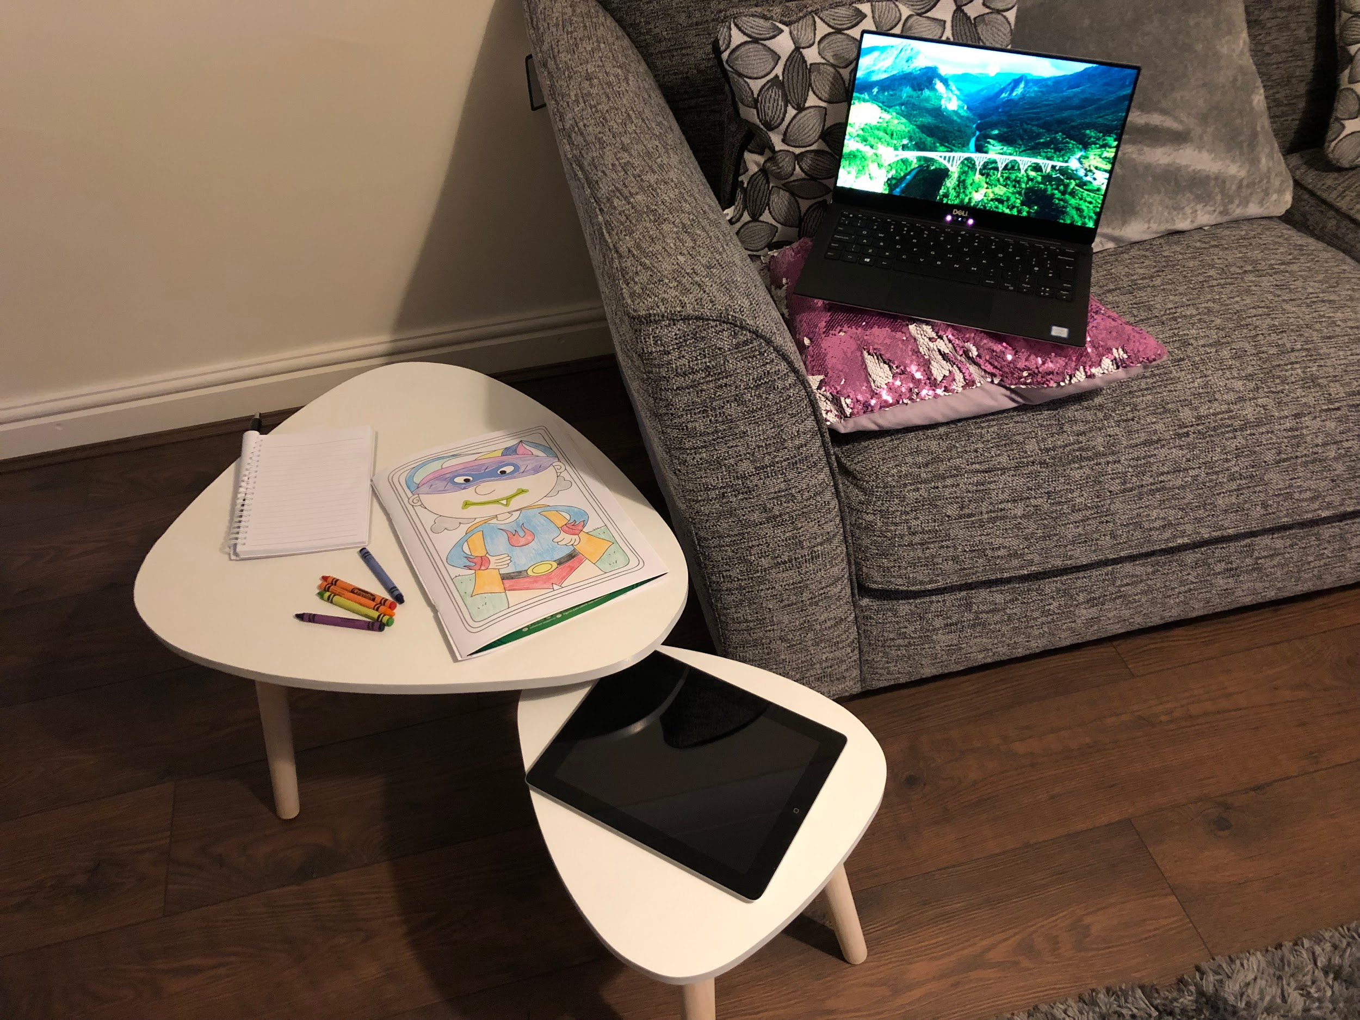

Slide 7
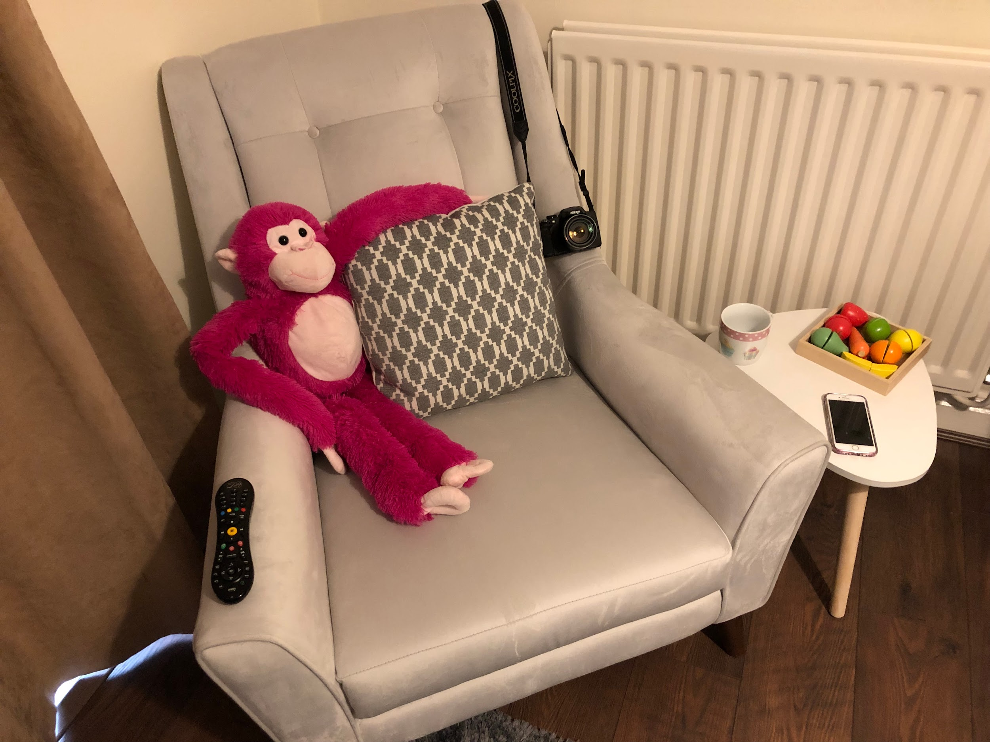

Slide 8
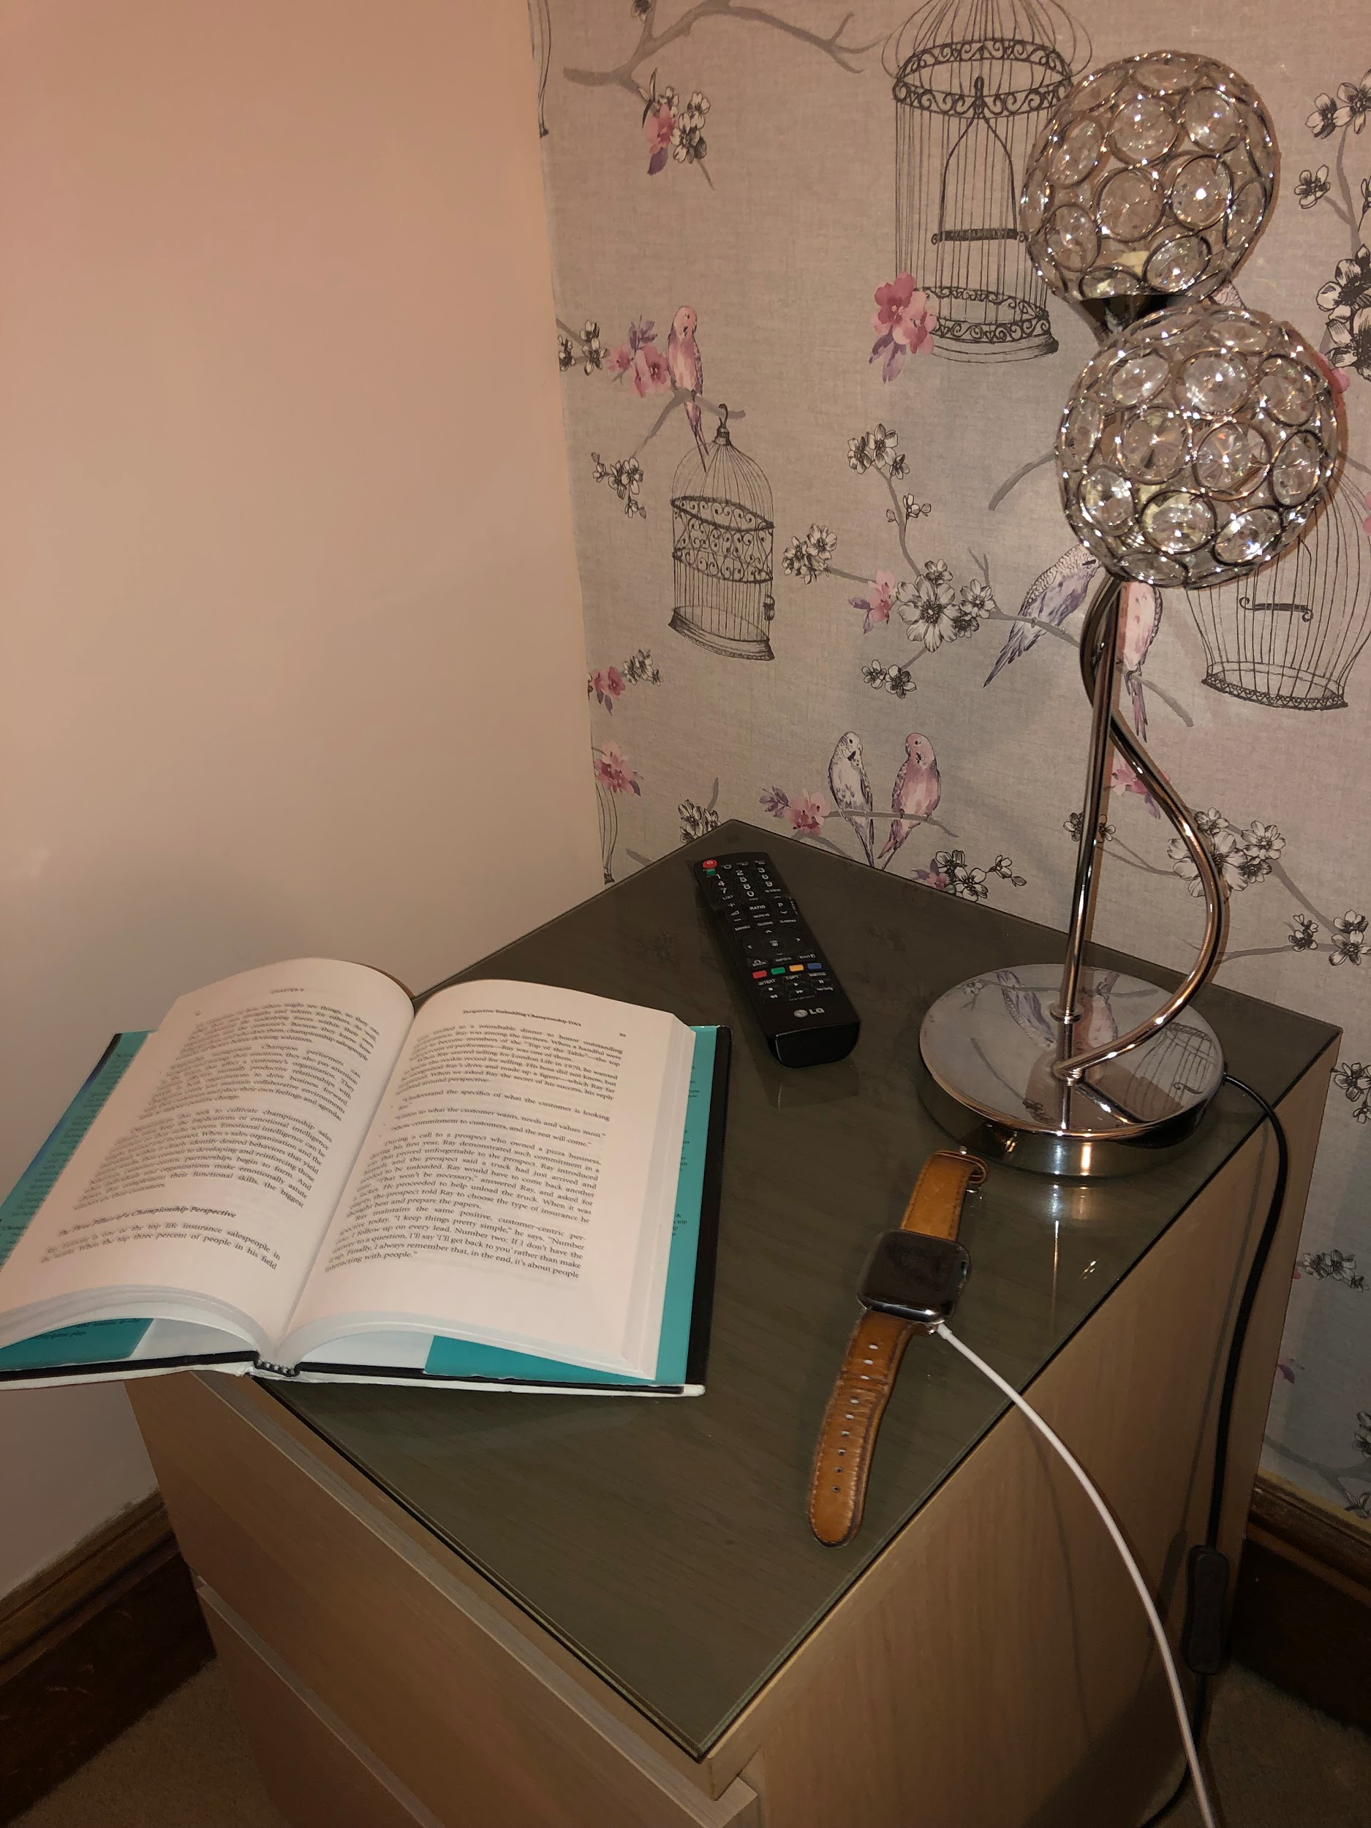
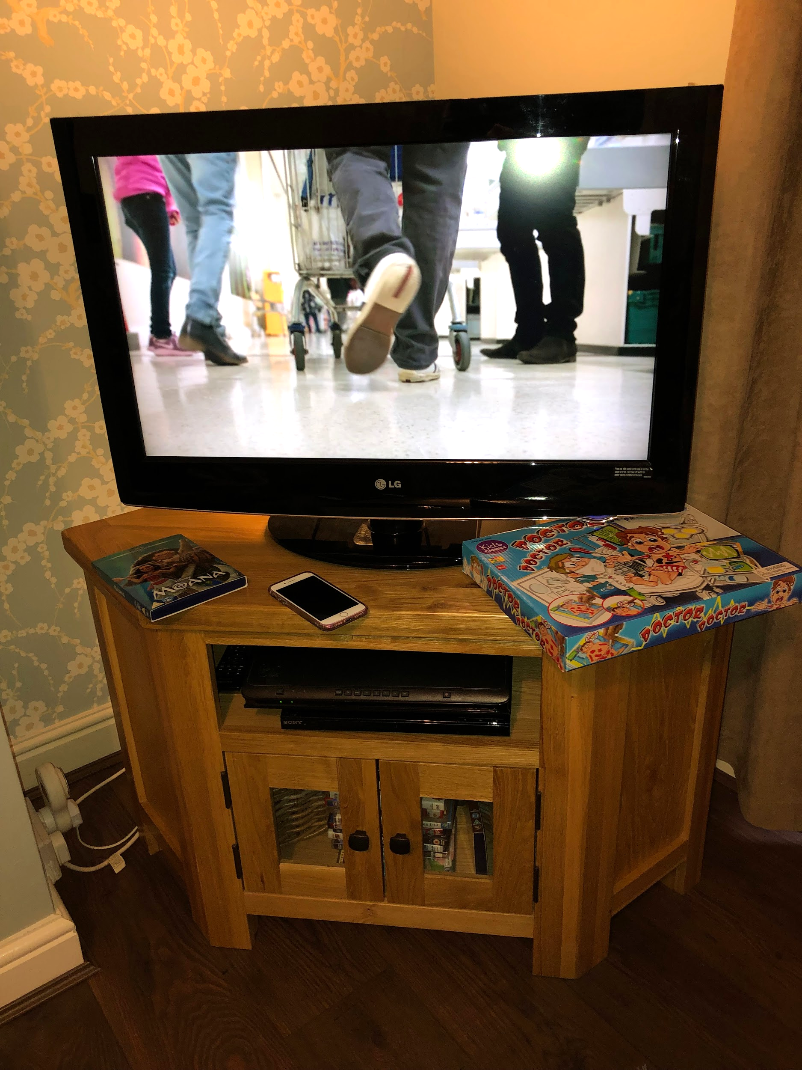

Slide 9
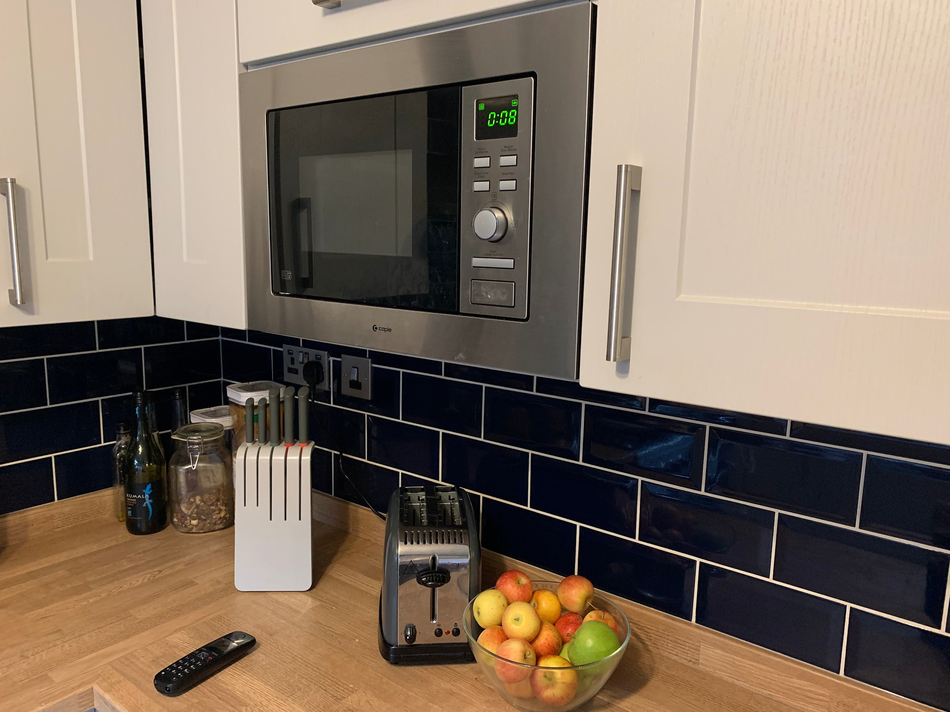

Slide 10
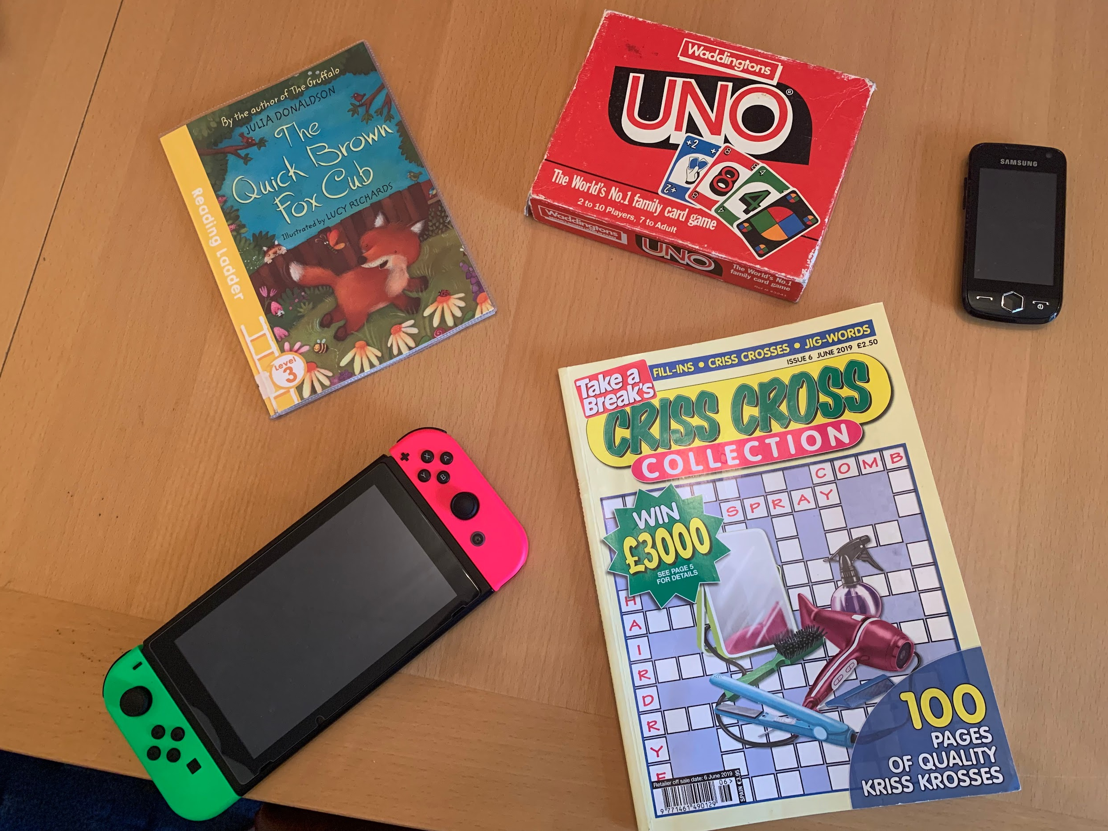

Slide 11
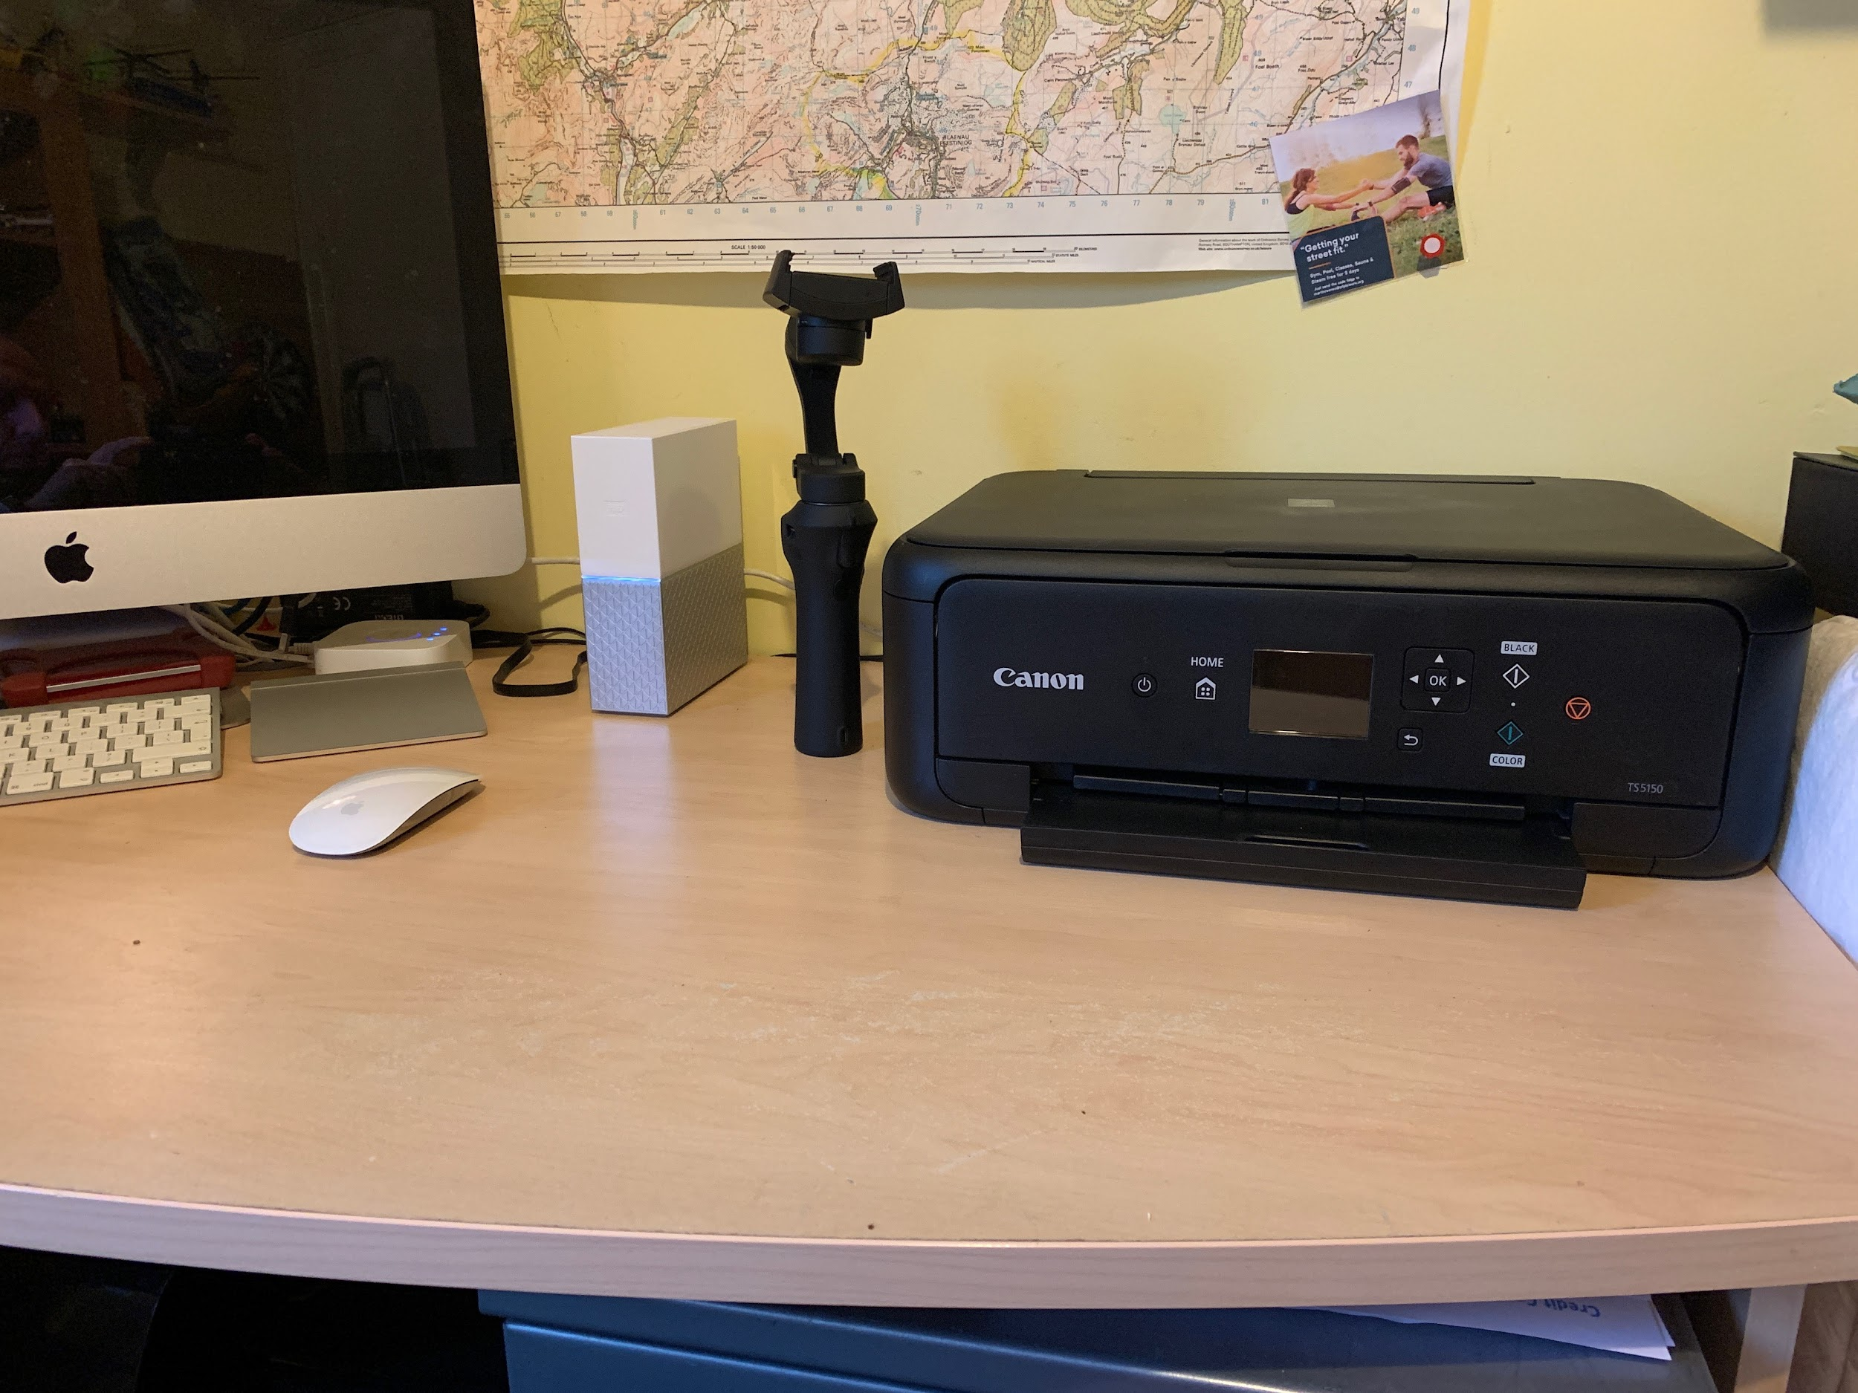

Slide 12

Your turn - technology walk!

Slide 13





Your choice

