Slide 1

Online Scenarios
I can recognise that I can say ‘no’ / ‘please stop’ / ‘I’ll tell’ / ‘I’ll ask’ to somebody who asks me to do something that makes me feel sad, embarrassed or upset.

Slide 2
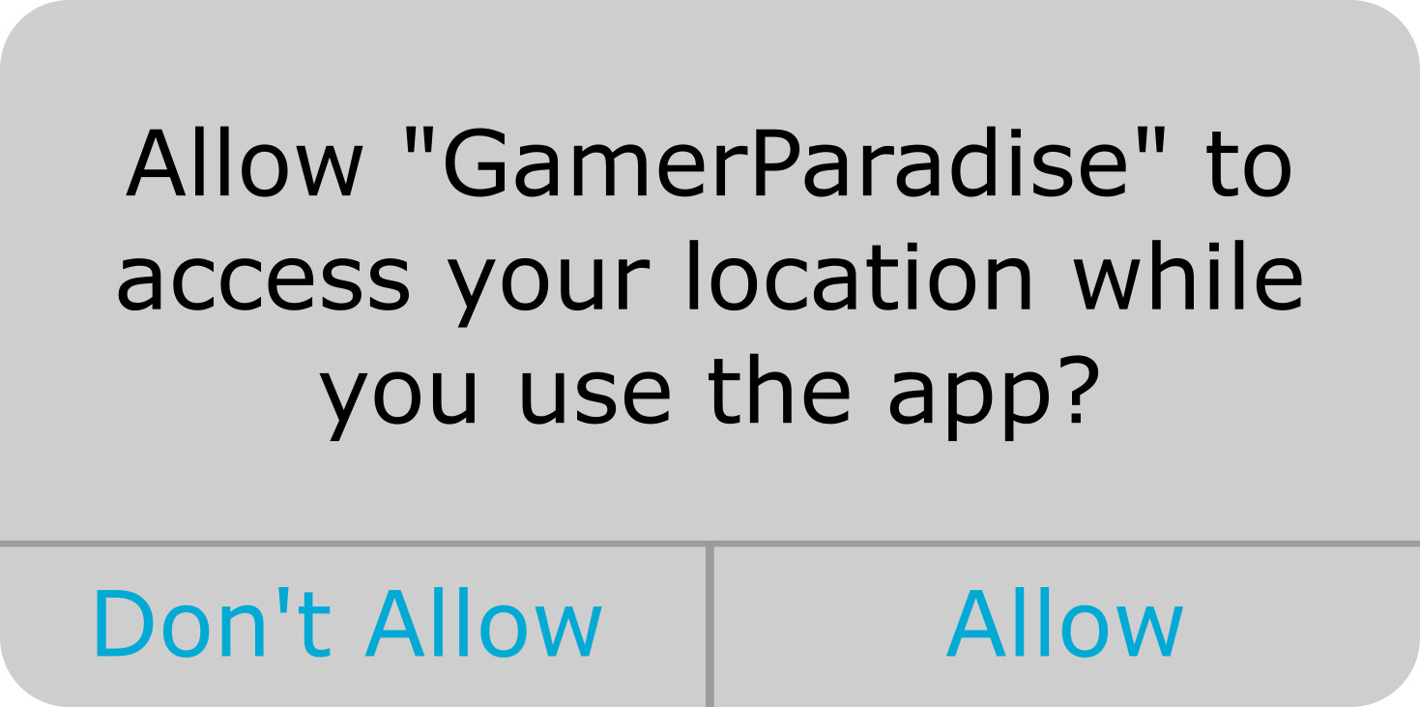
What would you do?
‘No’ ‘please stop’ ‘I’ll tell’ ‘I’ll ask’

Slide 3
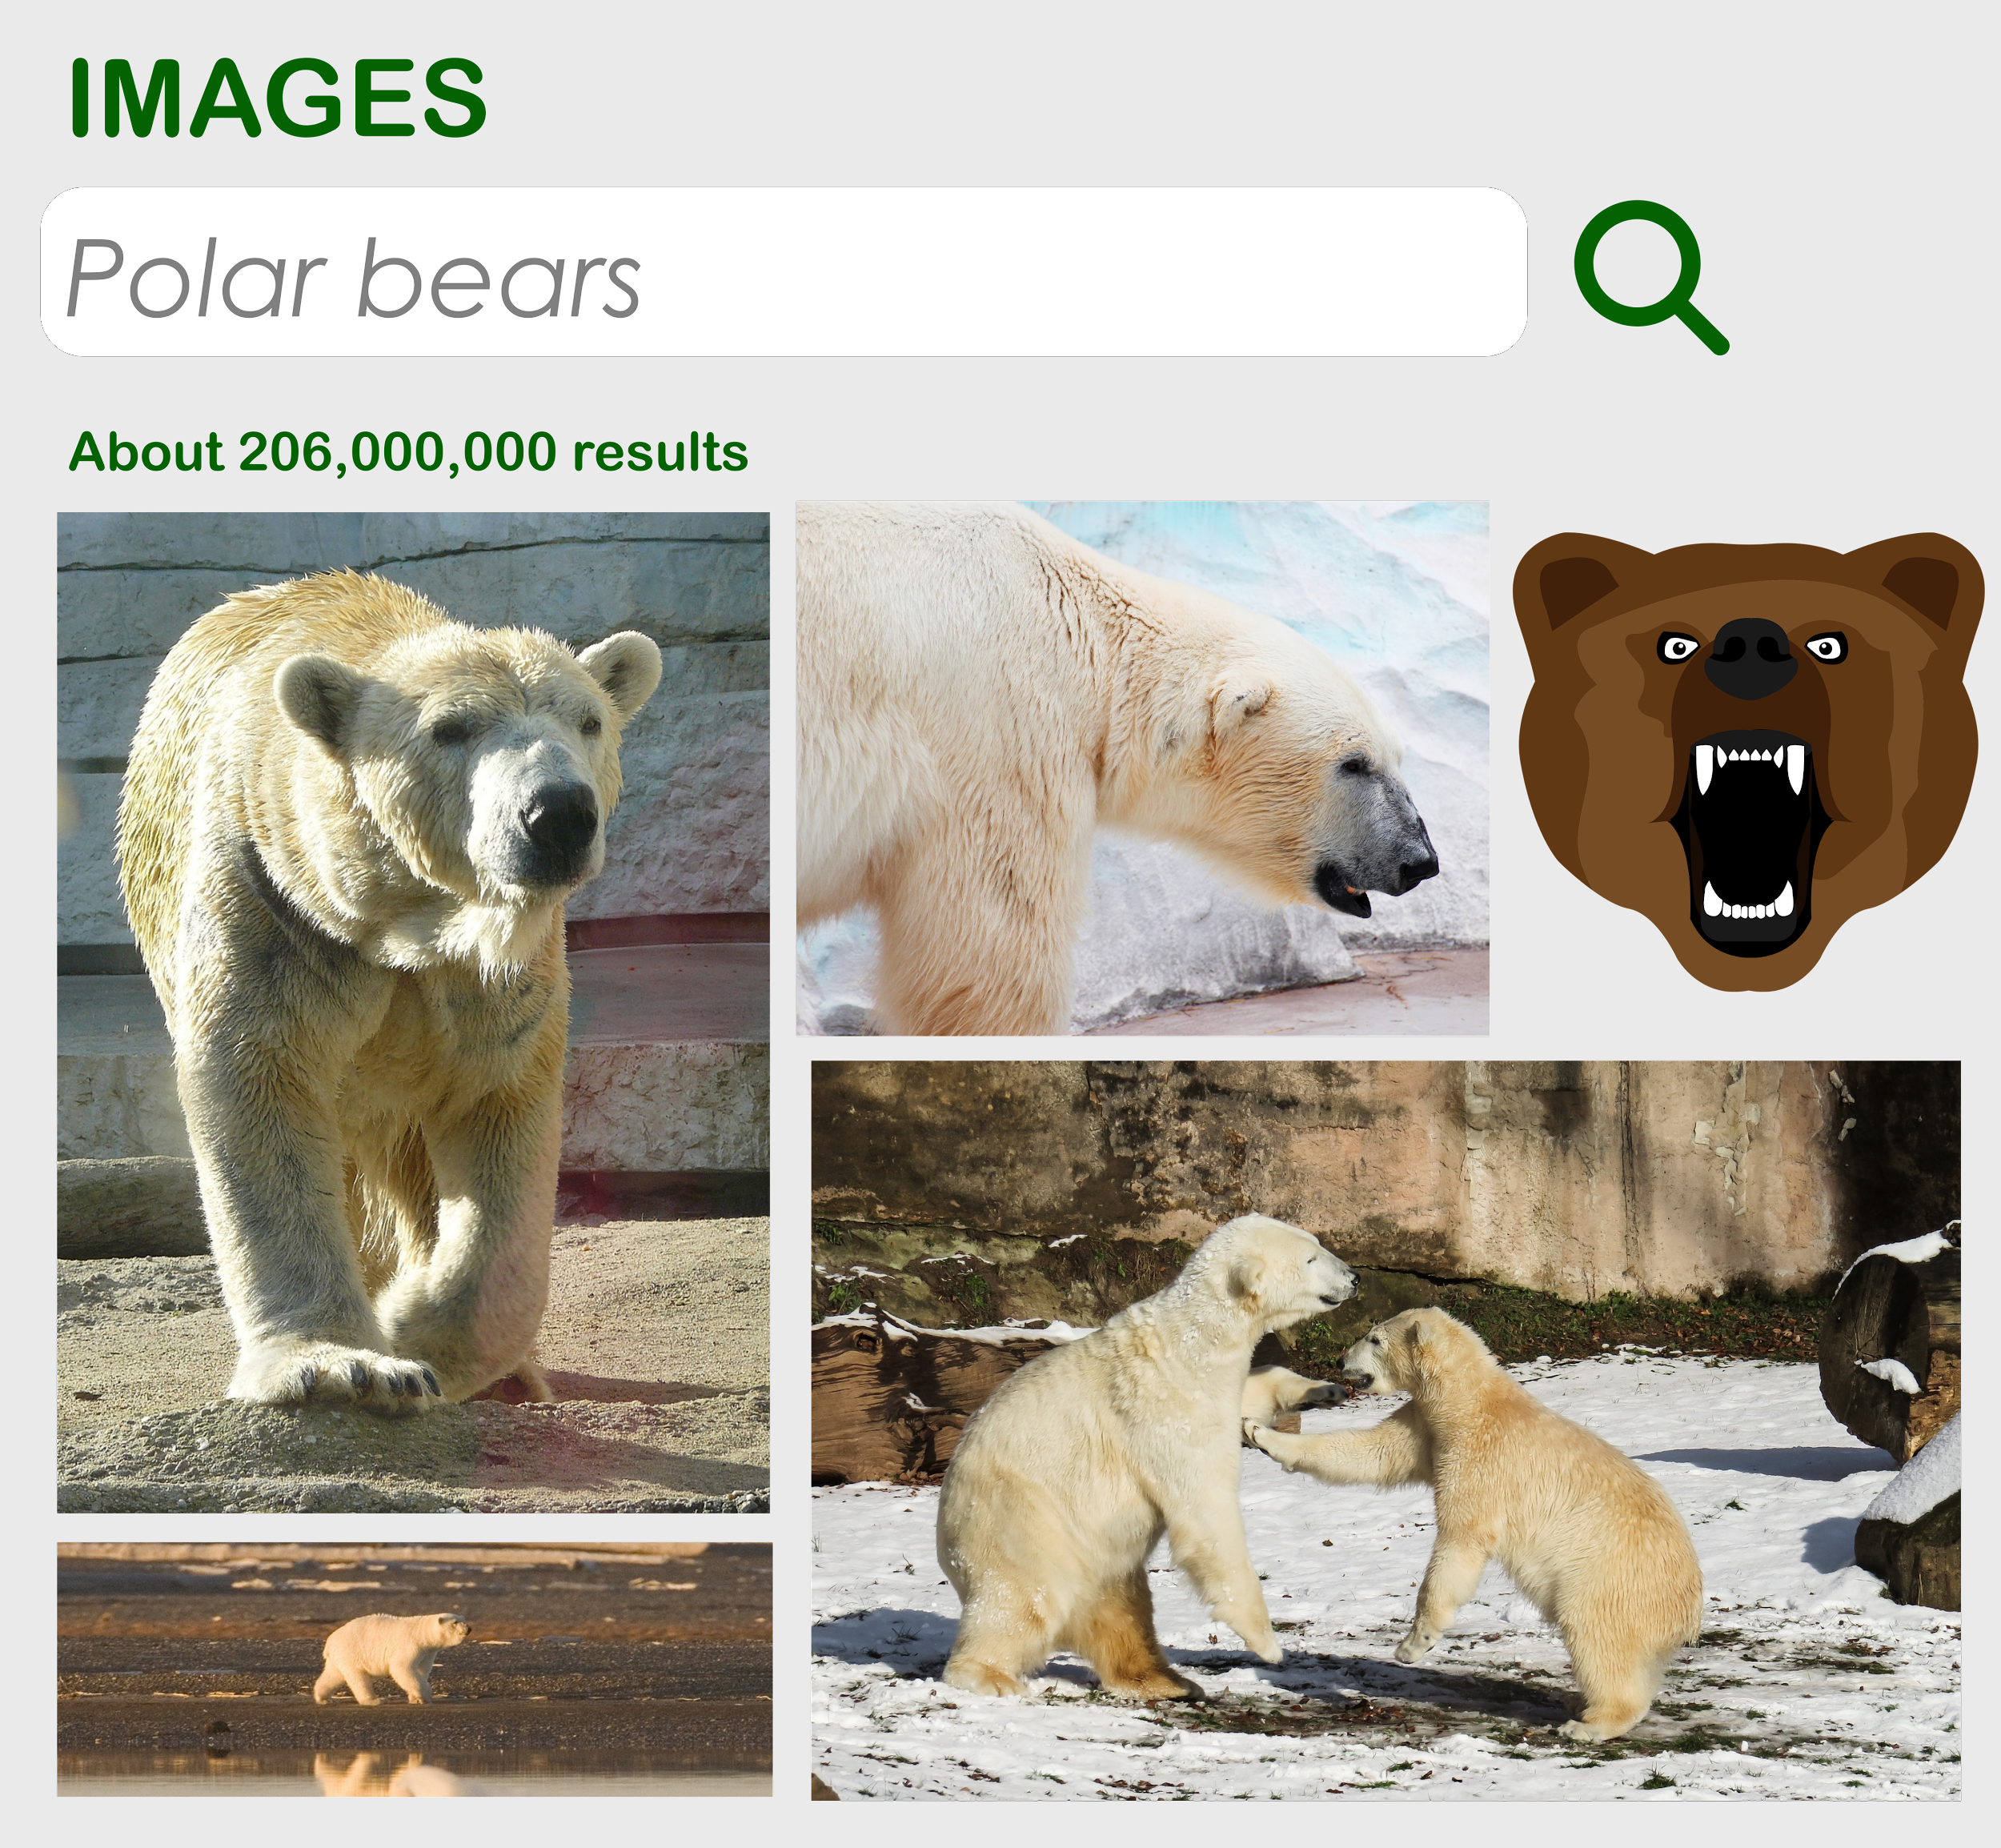
What would you do?
‘No’ ‘please stop’ ‘I’ll tell’ ‘I’ll ask’
Notes:
NB - The scary picture is of a bear and not a polar bear. Sometimes other things can come up when we search for something, and these might worry or upset us. It’s really important to check with an adult before searching for something online and tell them if anything comes up which worries or upsets you

Slide 4
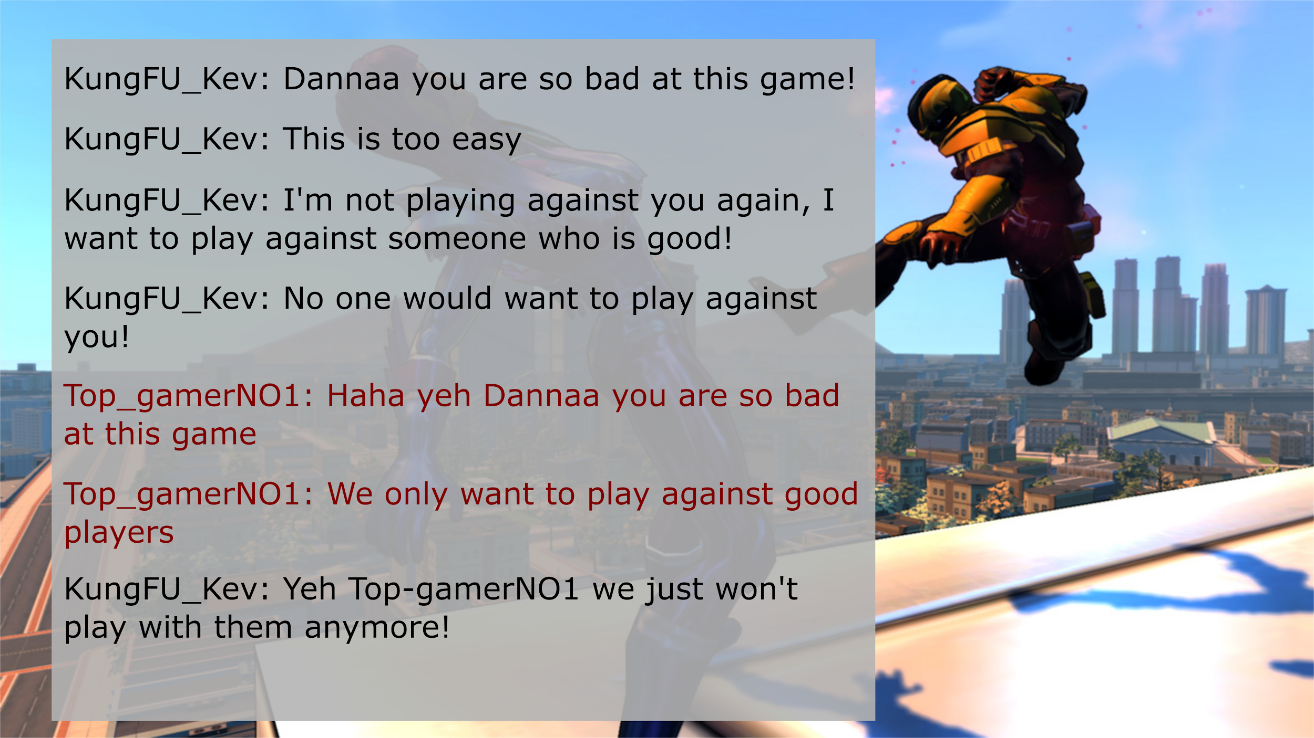
What would you do?
‘No’ ‘please stop’ ‘I’ll tell’ ‘I’ll ask’

Slide 5
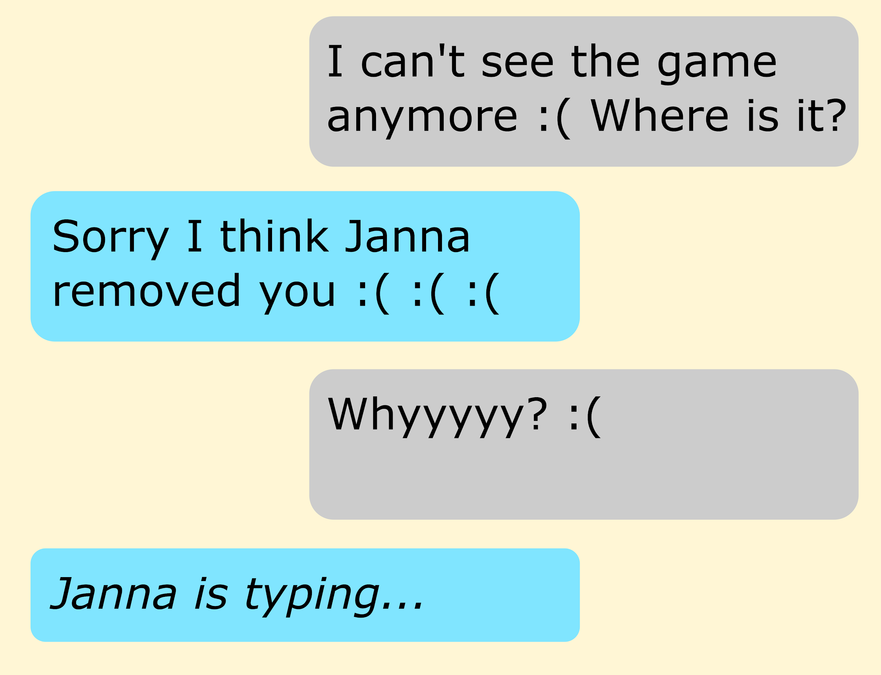
What would you do?
‘No’ ‘please stop’ ‘I’ll tell’ ‘I’ll ask’

Slide 6
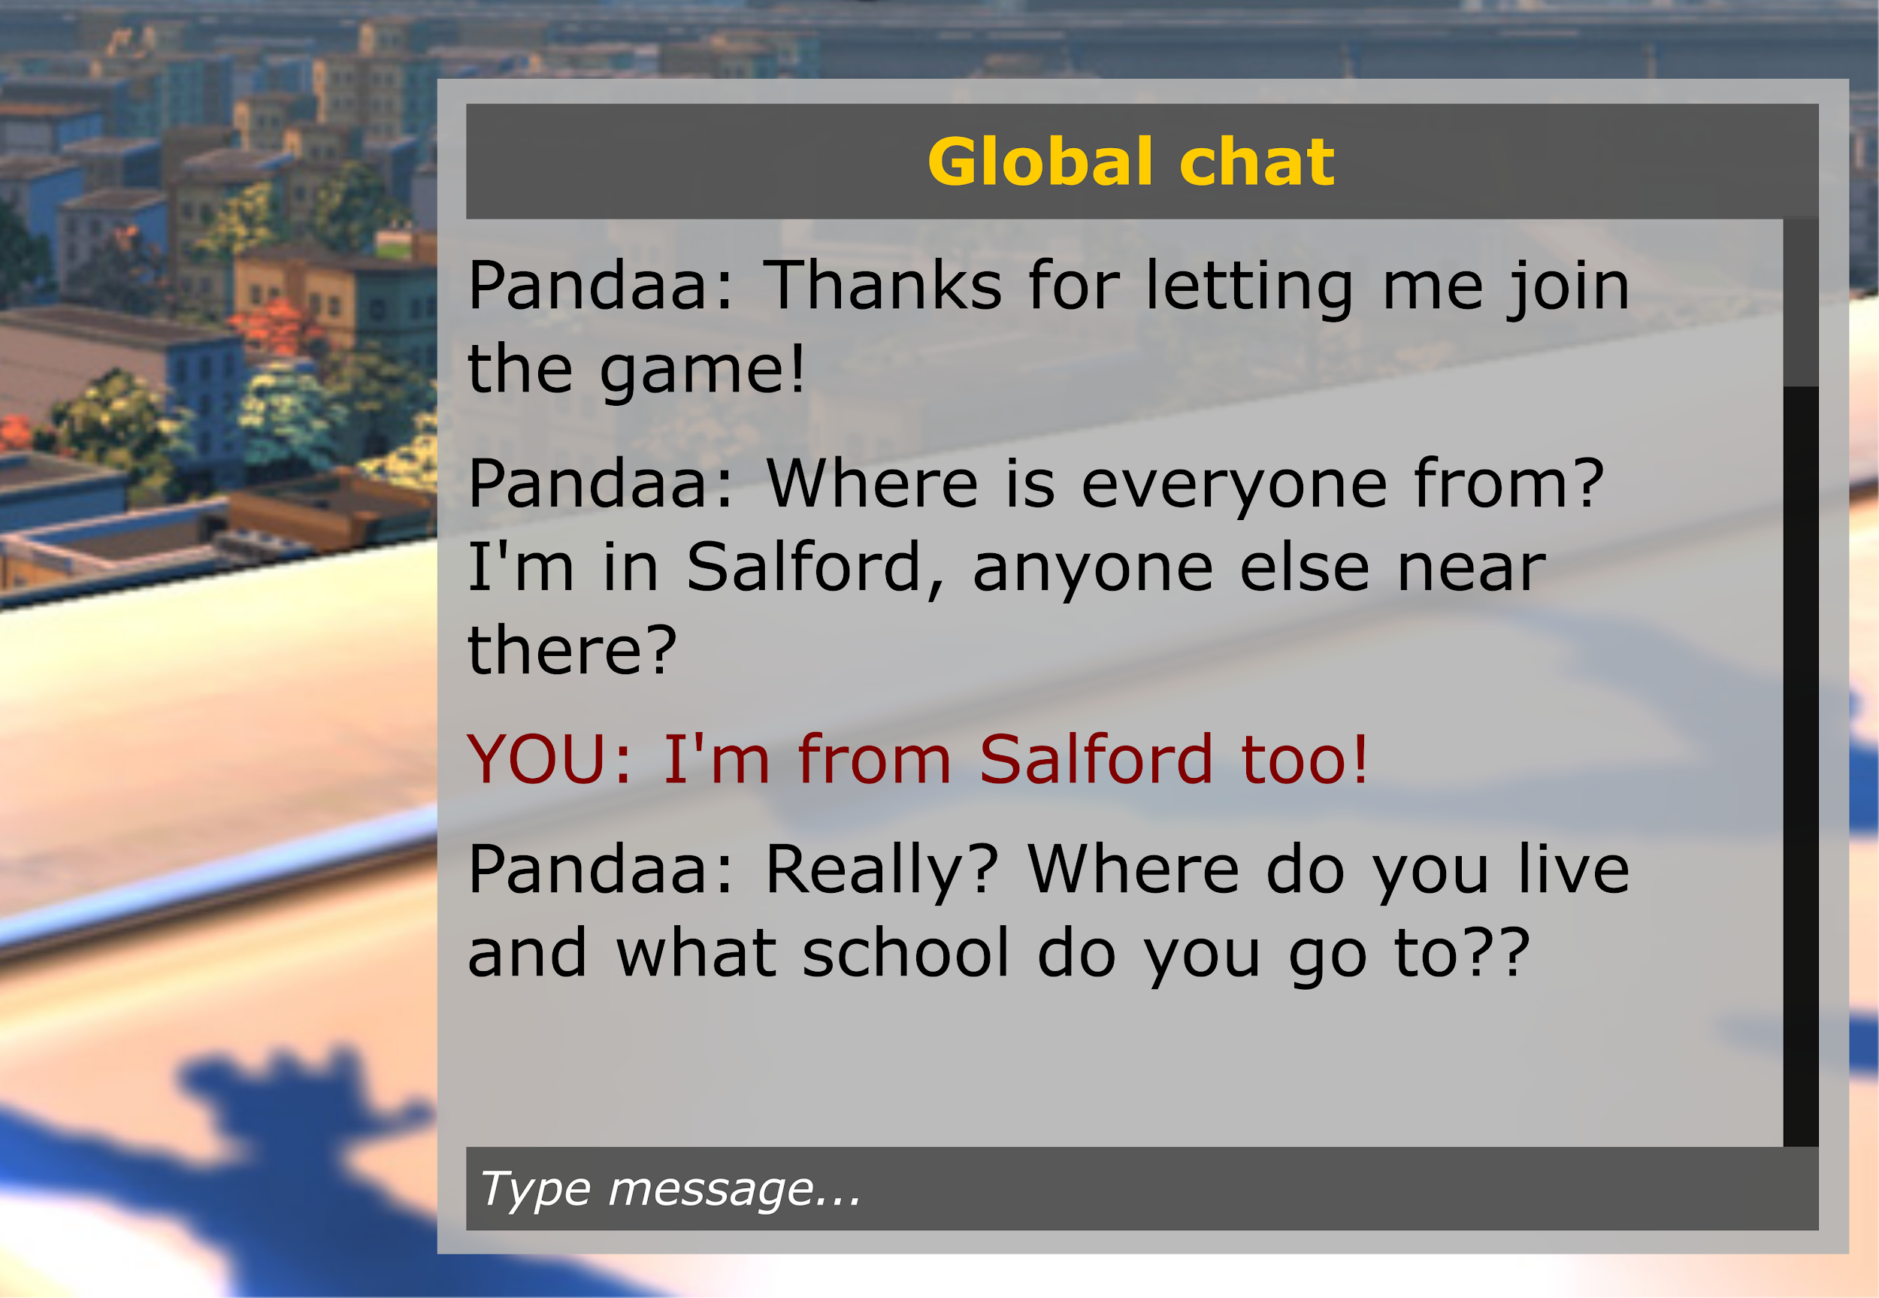
What would you do?
‘No’ ‘please stop’ ‘I’ll tell’ ‘I’ll ask’

Slide 7
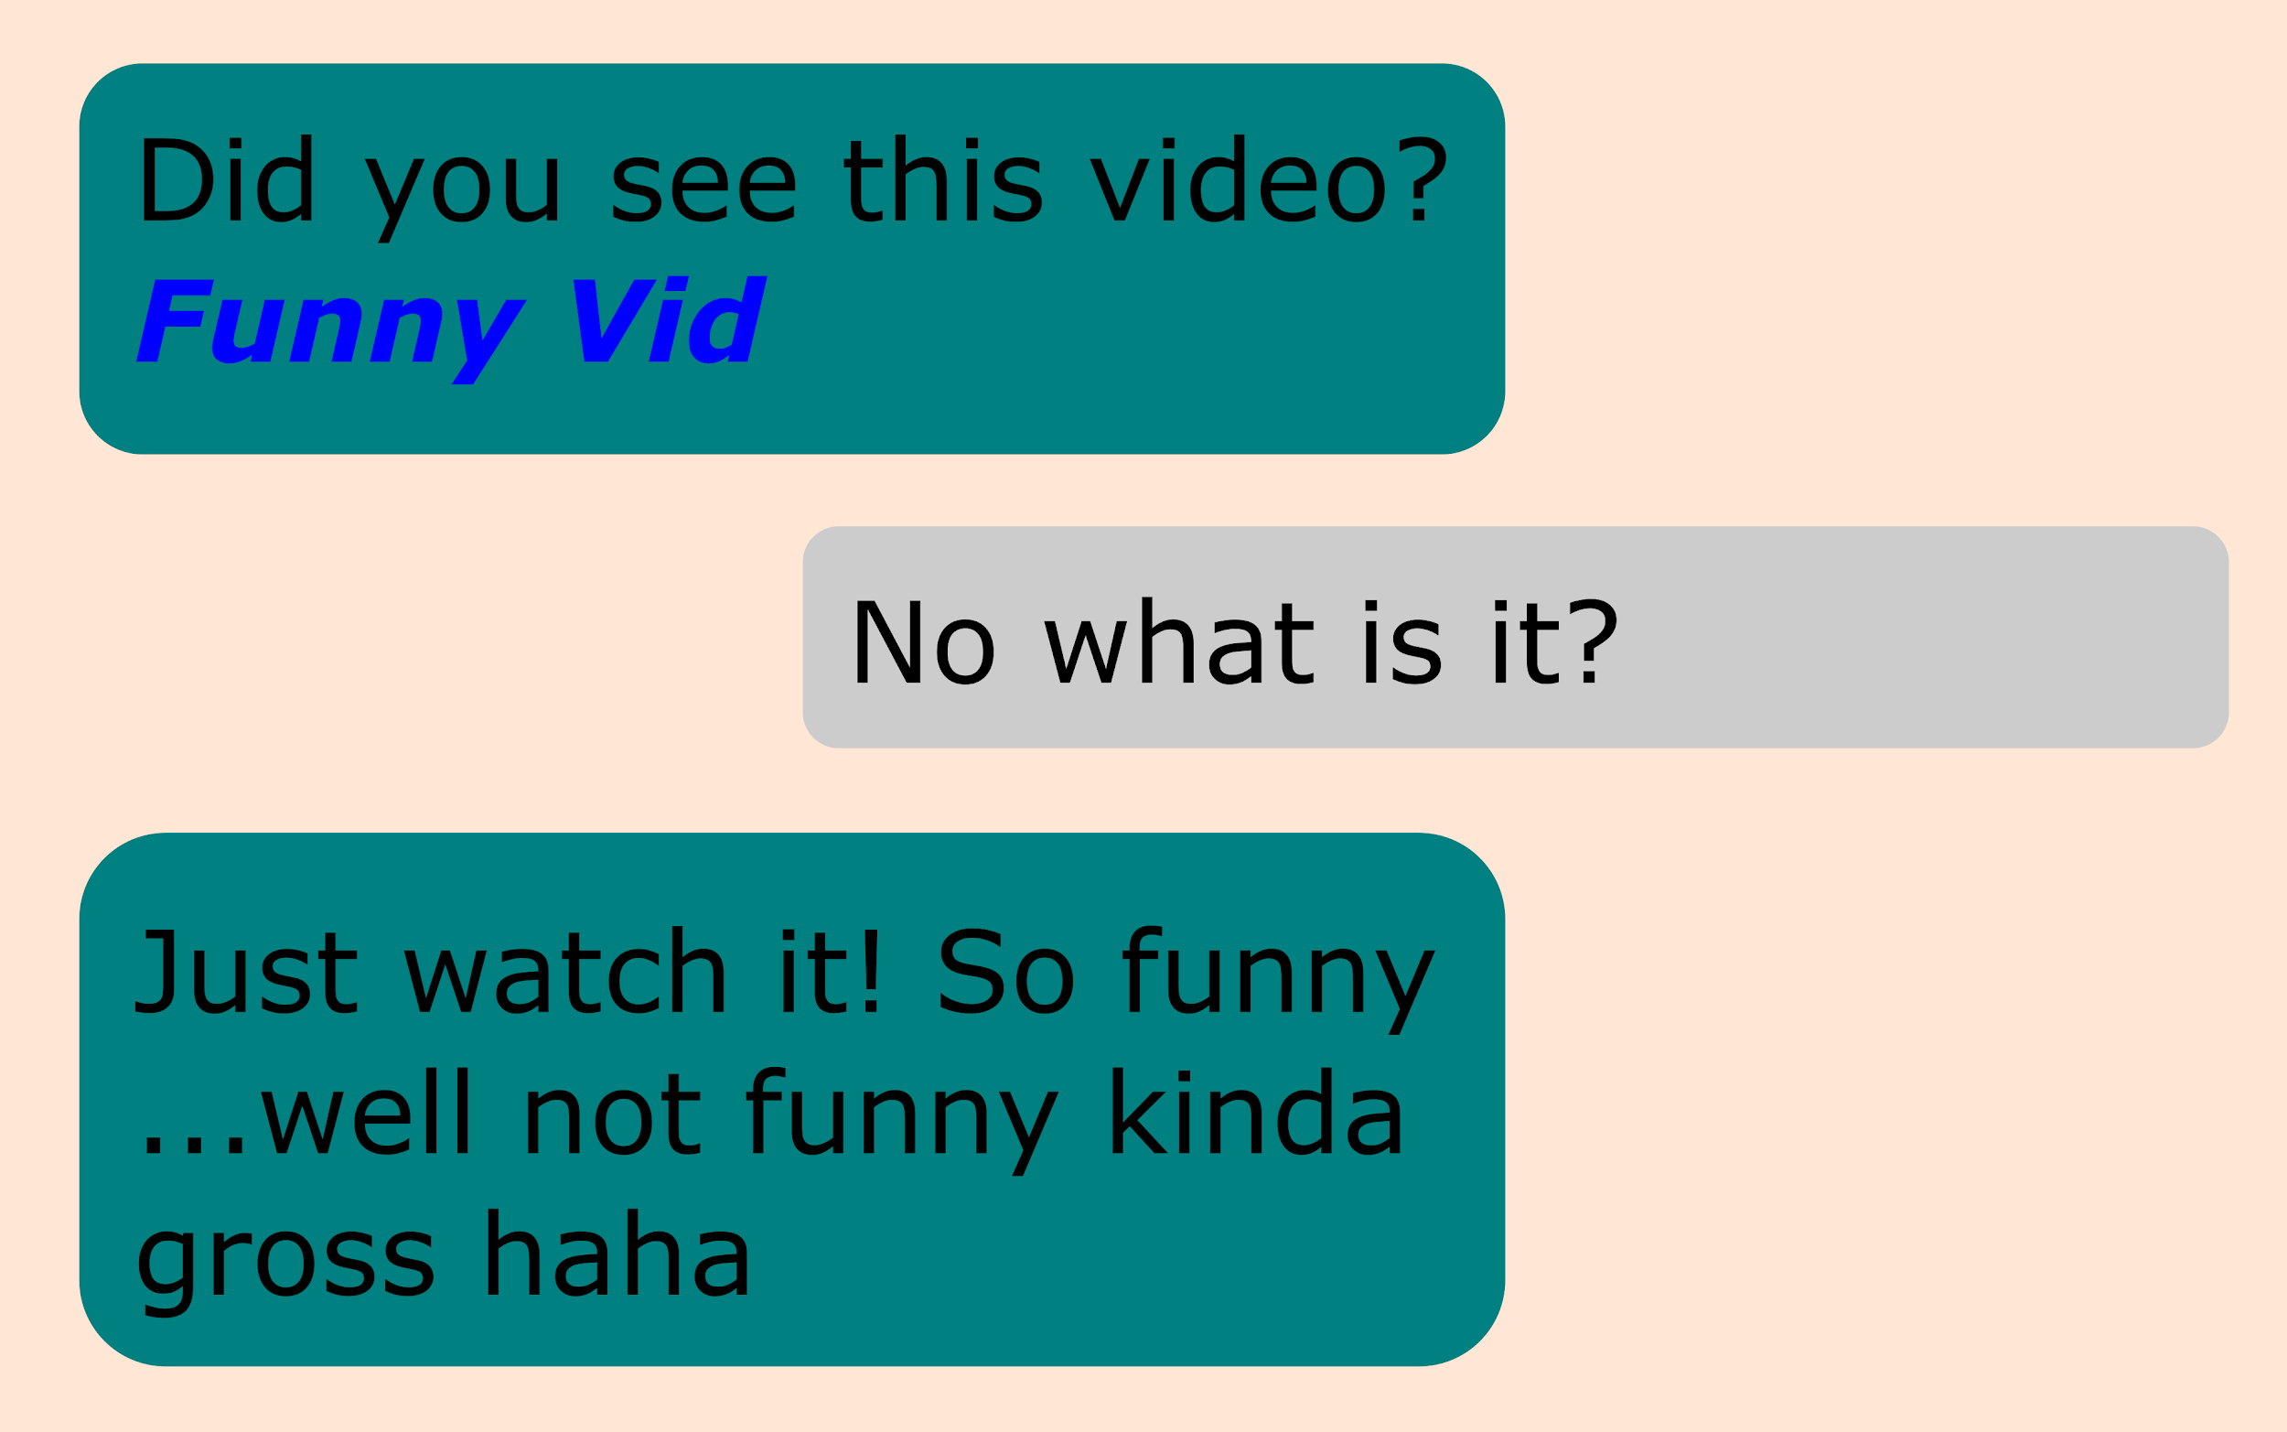
What would you do?
‘No’ ‘please stop’ ‘I’ll tell’ ‘I’ll ask’

