Slide 1

Keep me informed
I can identify ways that I can put information online.

Slide 2

i
n
f
o
r
m
a
t
i
o
n

Slide 3
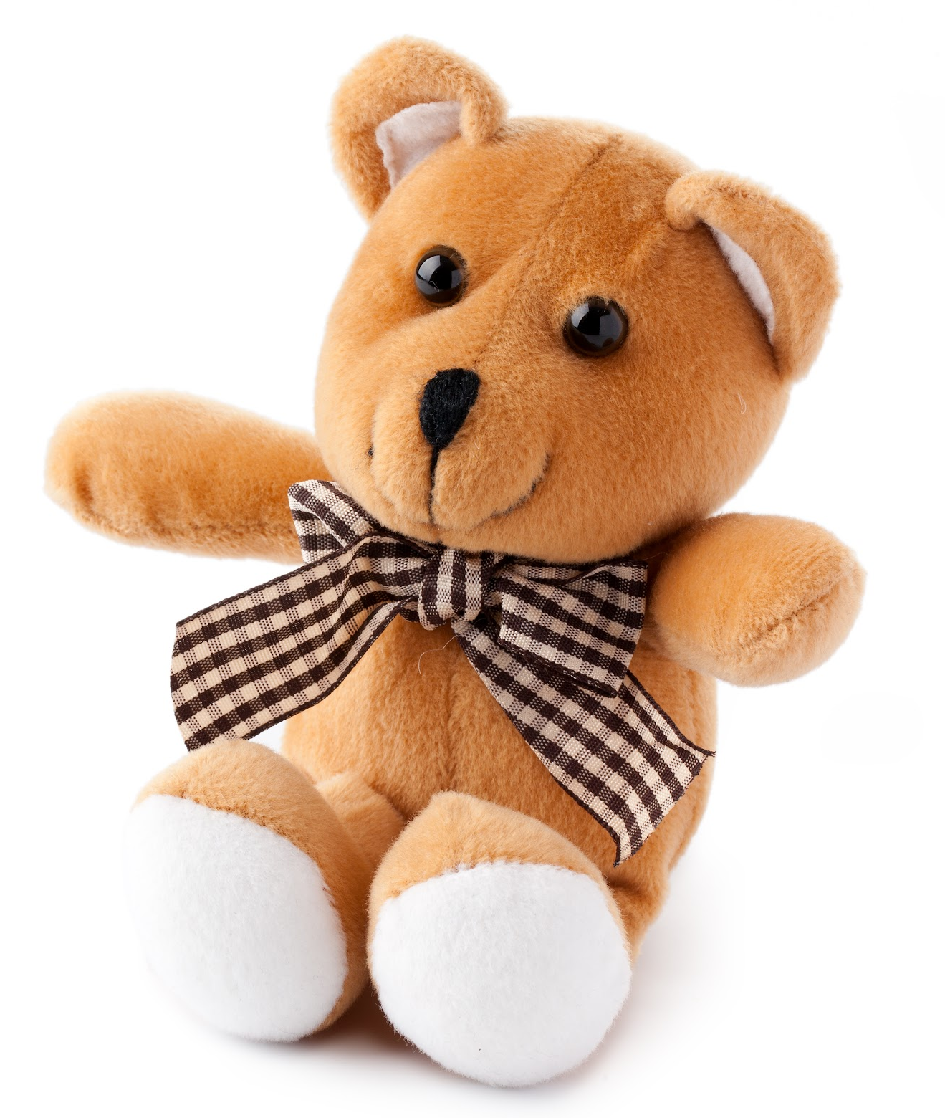
What is this?

Slide 4
What colour is it?

Slide 5
What is it wearing round its neck?

Slide 6
What is its name?

Slide 7
Who does it belong to?

Slide 8
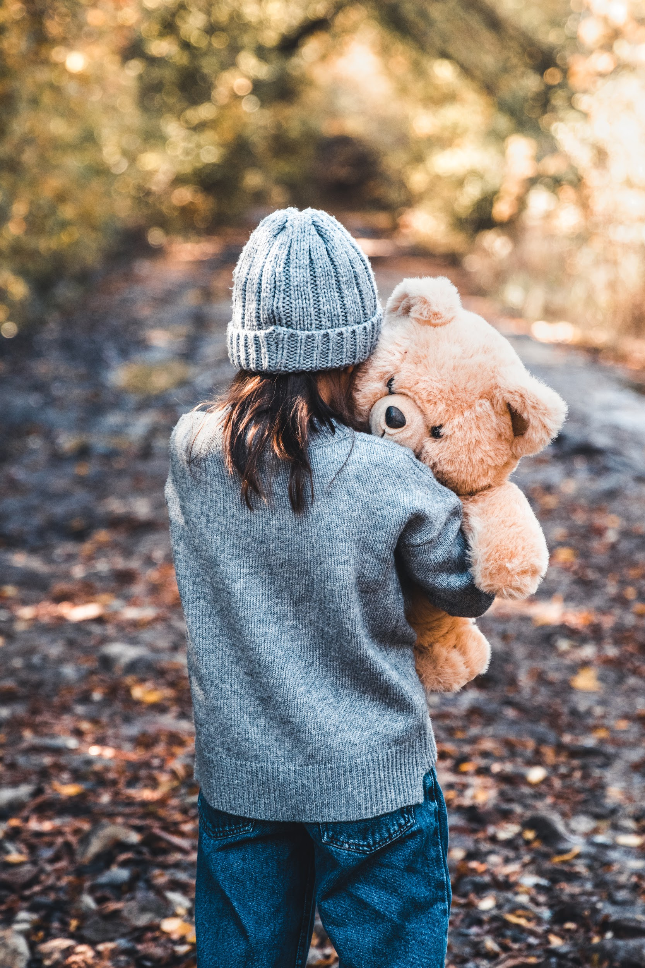
This is Saffron. She is holding her favourite teddy bear Cuddles.

Slide 9
If something is online it means...
Connected to a computer
Others can see it
Using an app
Watched on tablet or computer
On paper
Private
In a book
On the internet
Tick the ones which you think are right. 😊

Slide 10



Is it online information?
My blog
Yes
No

Slide 11

Is it online information?
Yes
No

Slide 12

Is it online information?
Yes
No

Slide 13

Is it online information?
My poster
Yes
No

Slide 14

Is it online information?
Yes
No

Slide 15

Is it online information?
Yes
No

