Slide 1

Guess the file!
I can name my work so that others know it belongs to me.
I can save my work under a suitable title/name so that others know it belongs to me (e.g. filename, name on content).
I understand that work created by others does not belong to me even if I save a copy.

Slide 2
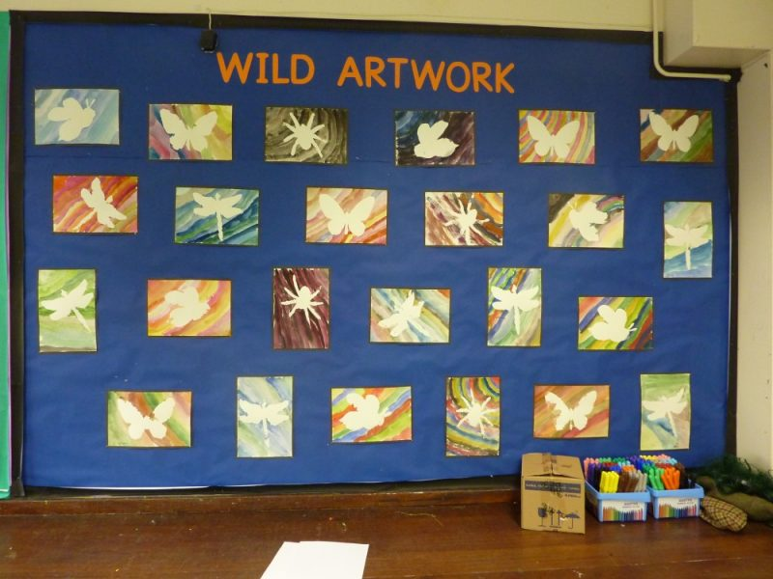
Whose work is this?

Slide 3
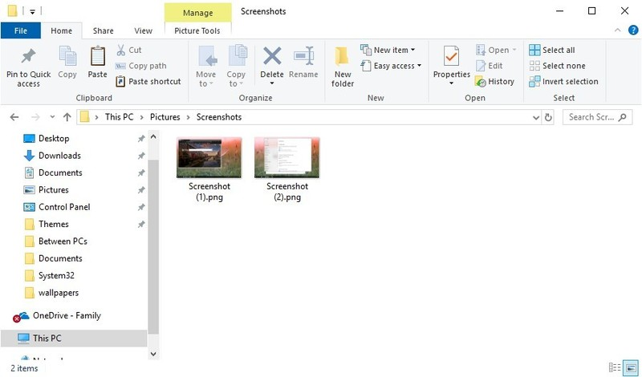
Whose work is this?

Slide 4
Which is better?
Jack’s Picture
My Picture
Jack’s Pirate Picture
Sams Monday Workout Pics
Charity’s Work
Charity’s School Work
Charity’s River Work

Slide 5



Pdf document
Used for making sure text and image documents dont change
JPEG image
This is an image file, likely to be a picture
Word document
Used for creating text and image documents

Slide 6


Is it mine now?
Macy took a photo of her kitten.
I copied the photo and changed the name to my kitten.jpg.
my kitten.jpg
Macy-kitten.jpg
Is it my photo now?

