Slide 1



Year group: 6
Date of visit: 15th – 19th June 2020
Duration of stay: 5 days (Mon – Fri)

Slide 2


A Hampshire County Council centre
Located in Brockenhurst in the heart of the New Forest
Awarded the Learning Outside the Classroom Quality Badge

Slide 3
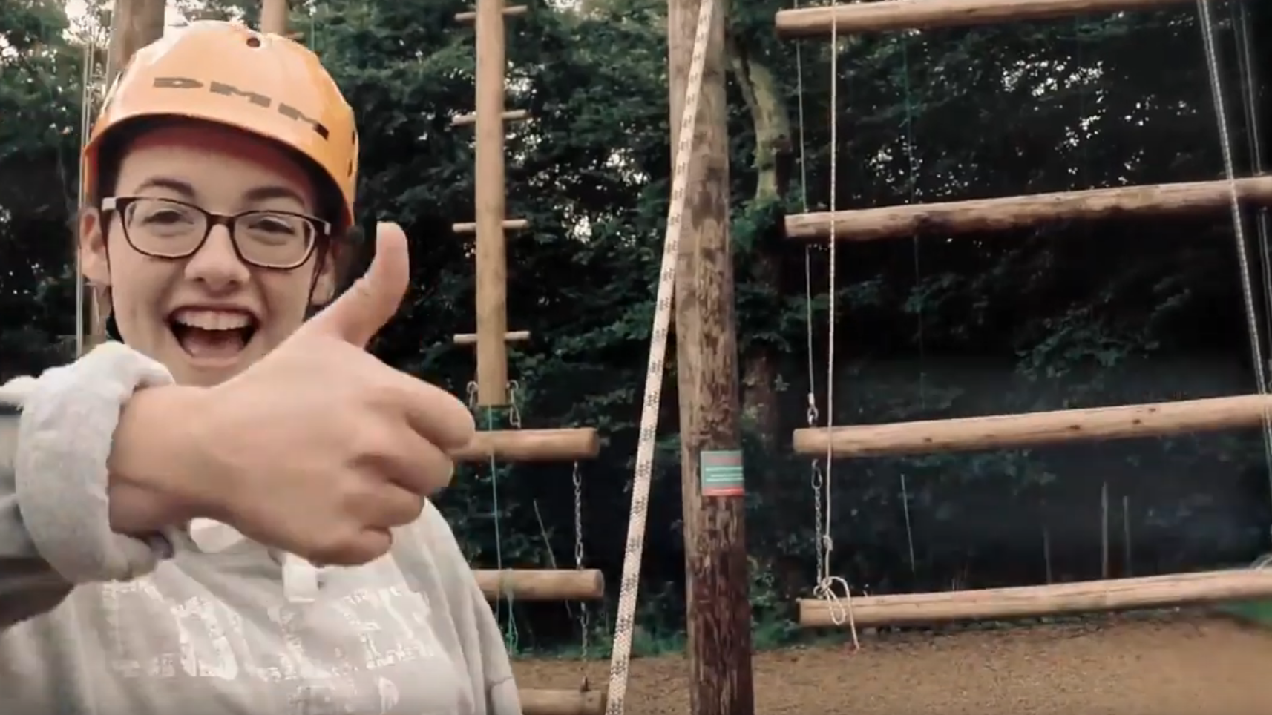
Watch our video here:
https://www.youtube.com/watch?v=hT1H8TgLeK8
https://www.youtube.com/watch?v=hT1H8TgLeK8

Slide 4


On-call overnight staff to assist in emergencies

Slide 5
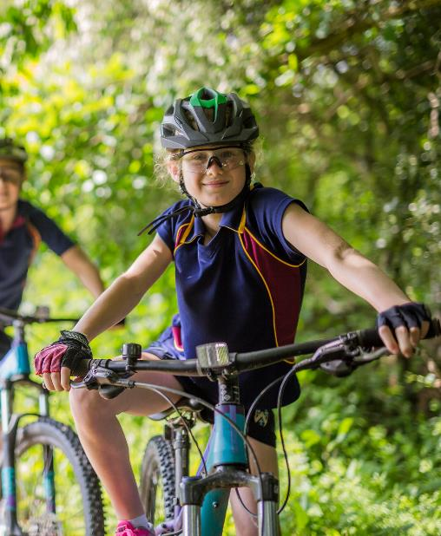
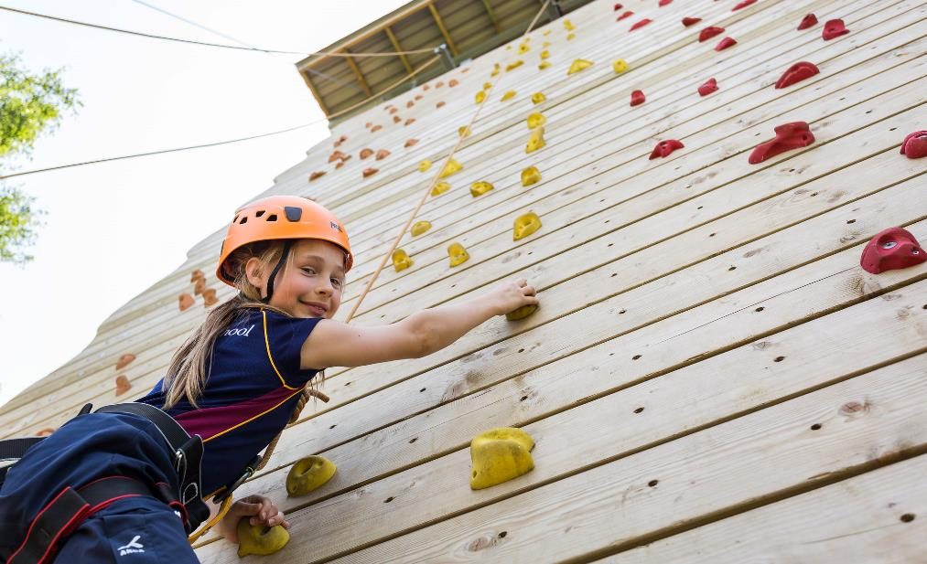


Slide 6






Slide 7
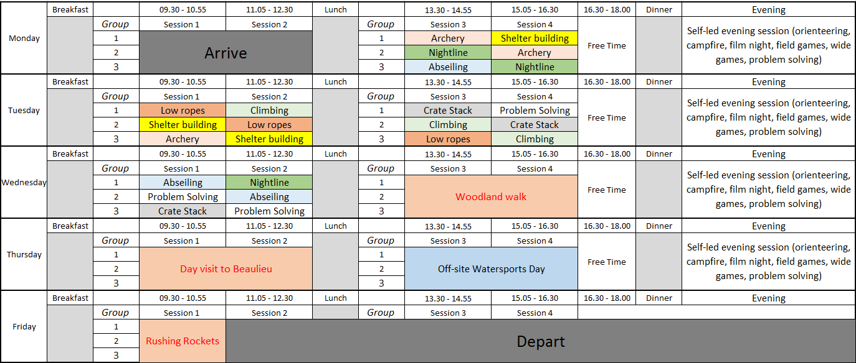
Sample Programme
(May vary)

Slide 8
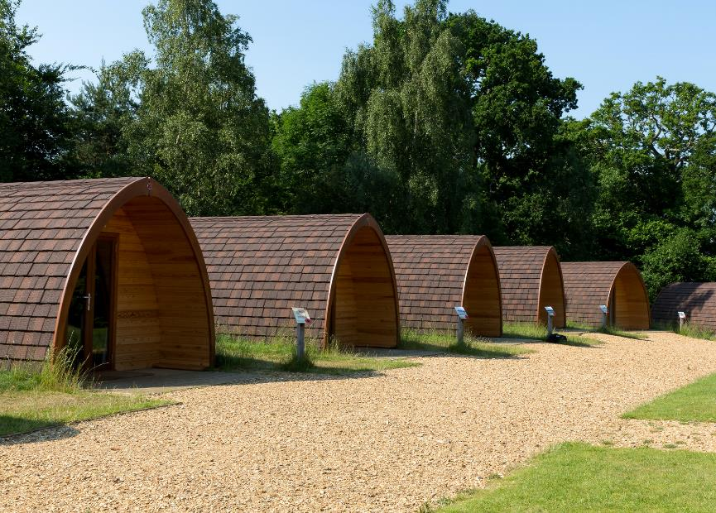
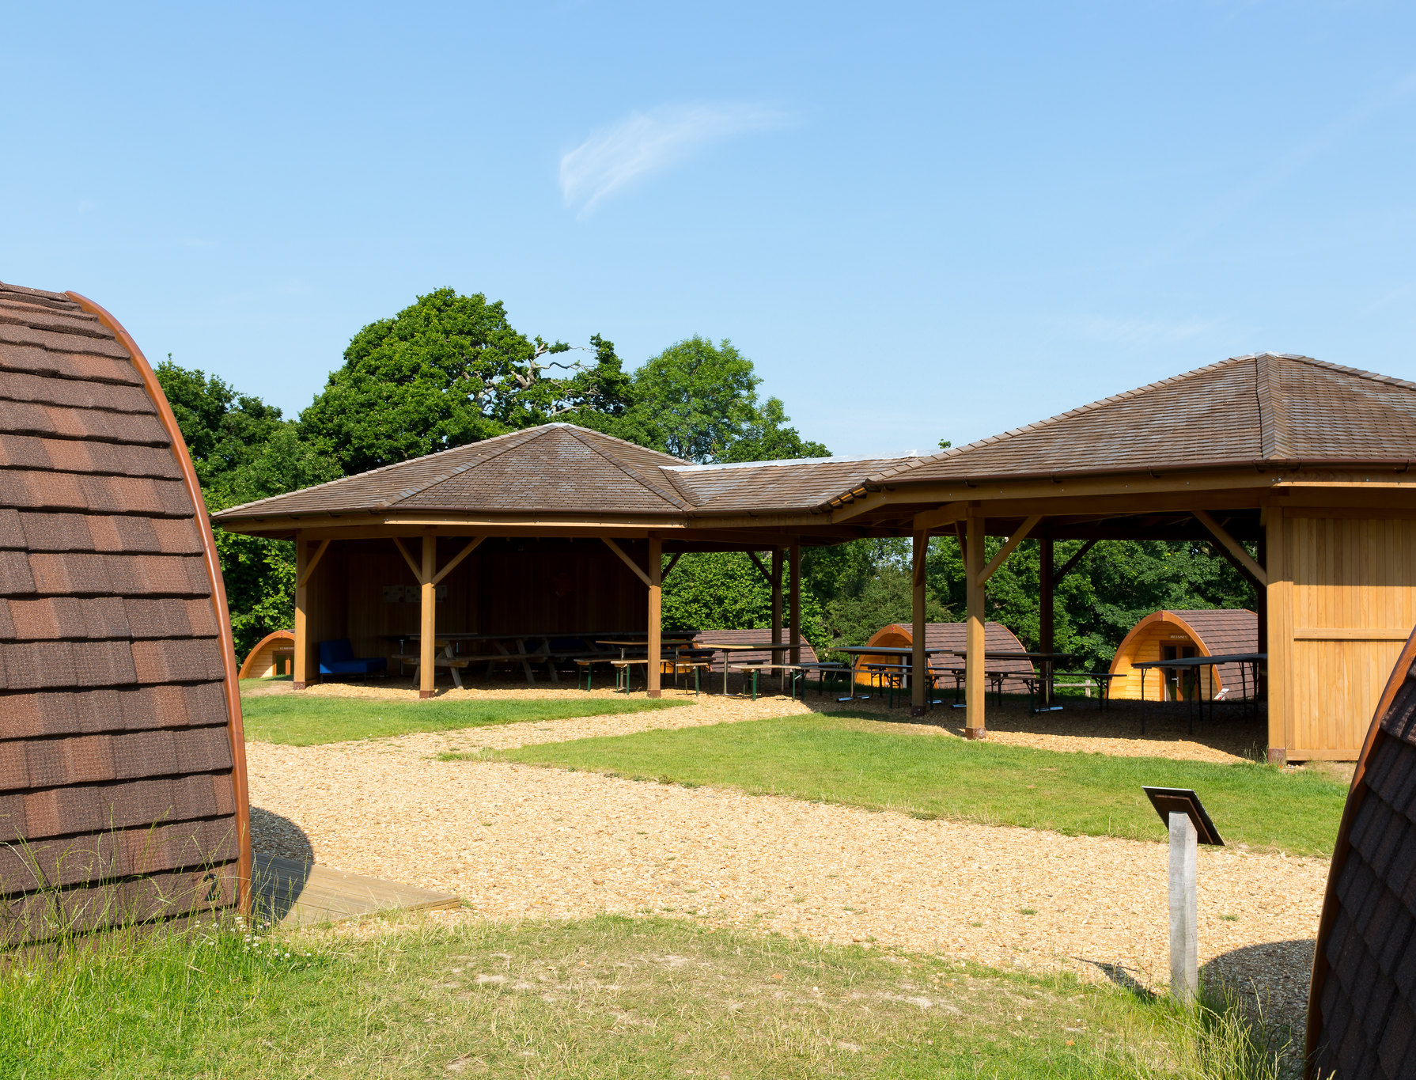
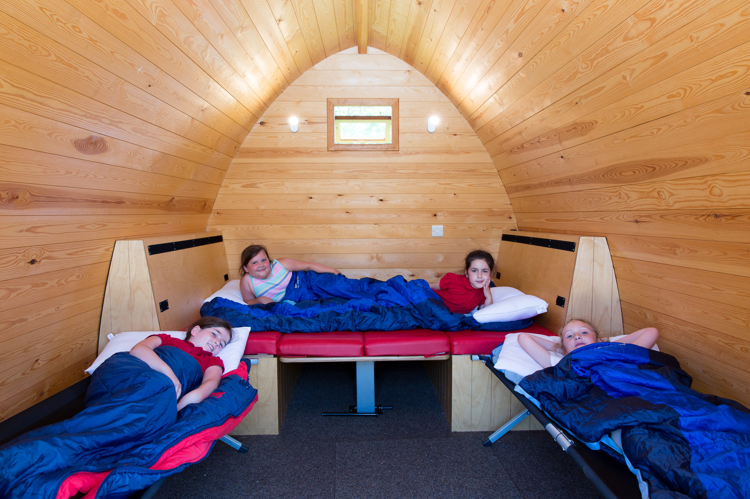
ACCOMMODATION
The Enda Ryan Poppy Pods
A luxury Camping Experience.
20 pods. 4 beds per pod.
Central Roundhouse.
Toilets/showers a short walk away.

Slide 9

Breakfast – 08:00
Fully served breakfast | Bacon, sausage, scrambled eggs, baked beans and hash brown | Selection of cereals with milk and dairy alternative, toast with butter and preserves | Tea, coffee, hot chocolate and fruit juice
Lunch – 12:30
Packed Lunch | Assorted selection of freshly made sandwiches | Assorted crisps, homemade sweet, piece of seasonal fruit | Bottled drink; either water or fruit based squash
Evening Meal – 18:00
Day of arrival | Chicken Tikka Masala served with rice, naan bread and mango chutney, or Macaroni Cheese served with crusty bread, vegetables and salad. |  |  | Apple Flapjack, fresh fruit or yoghurt Jugs of squash
Day 2 | BBQ – burgers and sausages served in soft bread buns with cheese and crispy onions, wedges and salad. Vegetarian options available. |  |  | Chocolate Crunch, fresh fruit or yoghurt Jugs of squash
Day 3 | Meatballs in tomato sauce served with spaghetti and garlic bread, or Moroccan roasted vegetables with couscous Served with salad. |  |  | Trifle, fresh fruit or yoghurt Jugs of squash
Day 4 | Jacket potato with beef chilli, or beans and cheese, or, Vegetable Enchilada pie Served with salad |  |  | Chocolate Brownie, fresh fruit or yoghurt Jugs of squash

Slide 10


All camping essentials required, such as; knife, fork, spoon, tea towel
Bedding required: bottom sheet, pillow, pillow case.
With either duvet and duvet cover or sleeping bag.

Slide 11
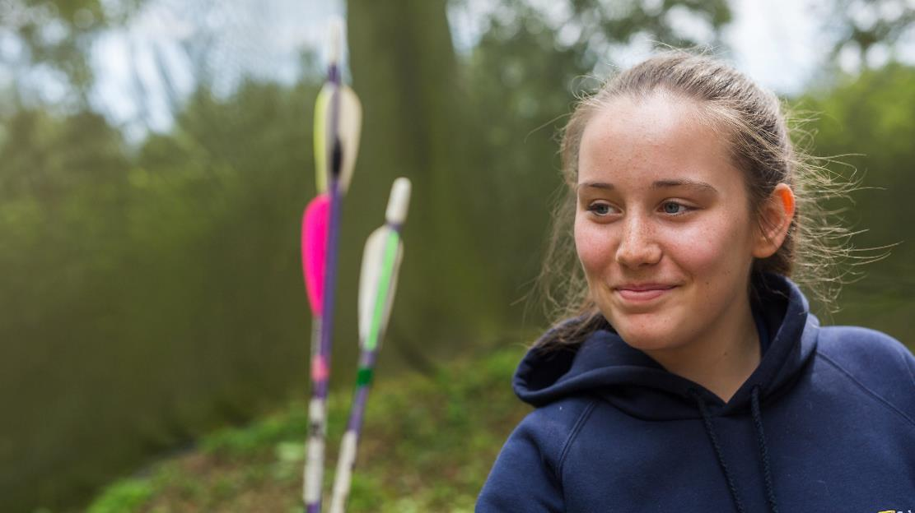


Thank you very much for letting us stay in your lovely pods and for letting us do amazing activities. Tile Barn is EPIC!
Connor, 10.
The programmes offered at Tile Barn Outdoor Centre are linked to the National Curriculum and help students to:

Slide 12


