Slide 1

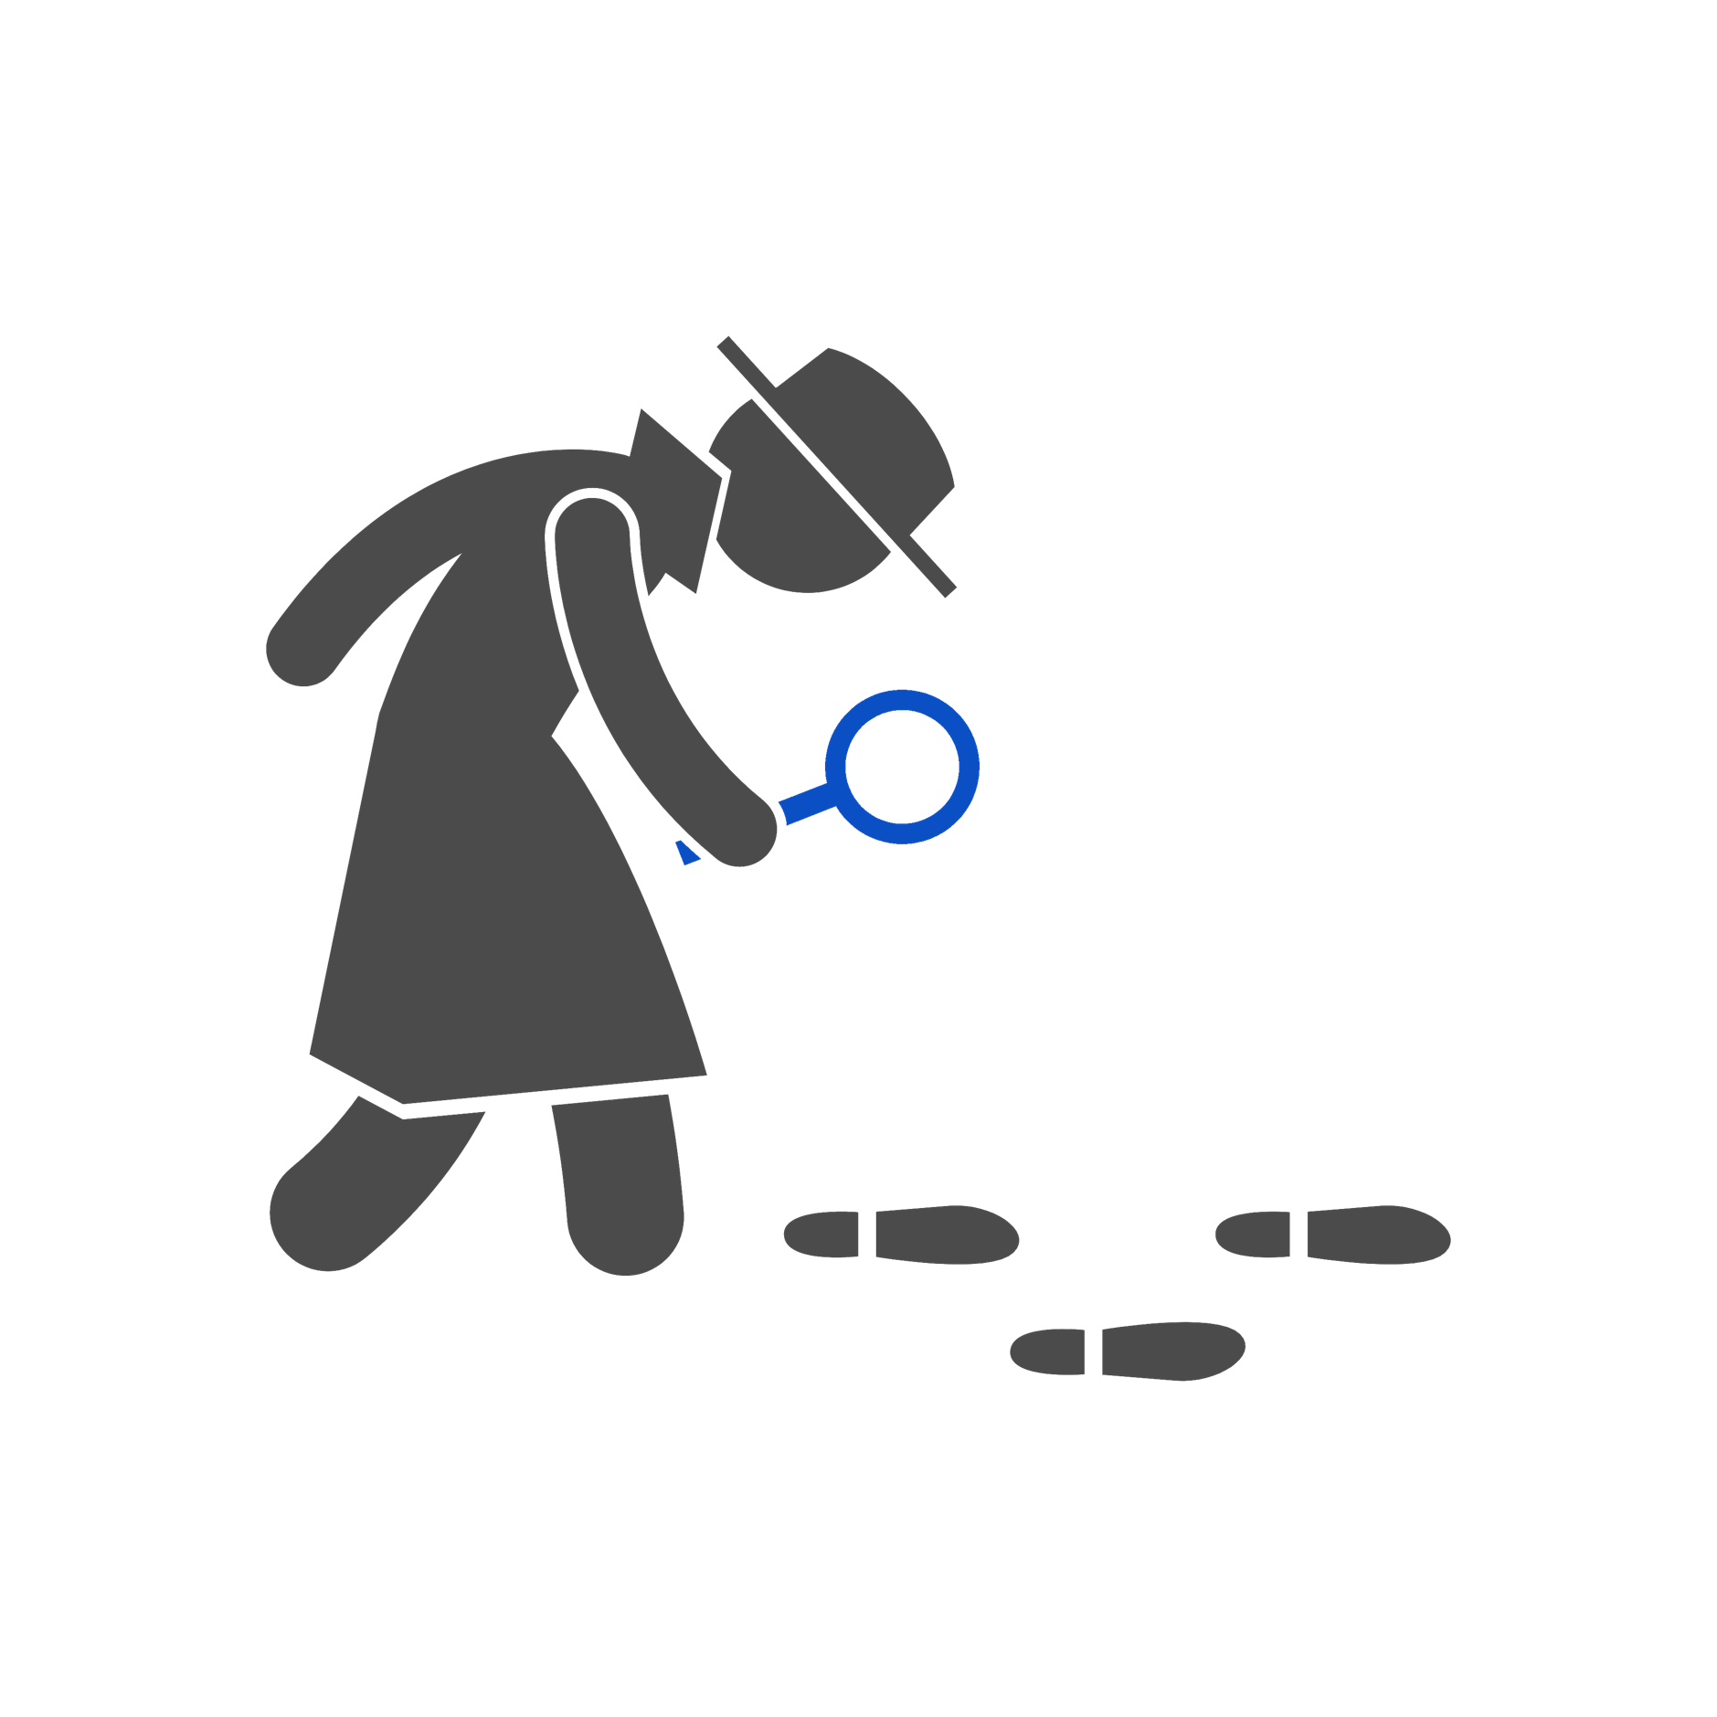
Spot the difference
I can describe ways that some people can be unkind online.

Slide 2


Being unkind
is…
‘Unkind online’
is…
being mean on games, social media, the internet and through a device.
‘Unkind face-to-face’
is…
being mean in person through words or actions.

Slide 3
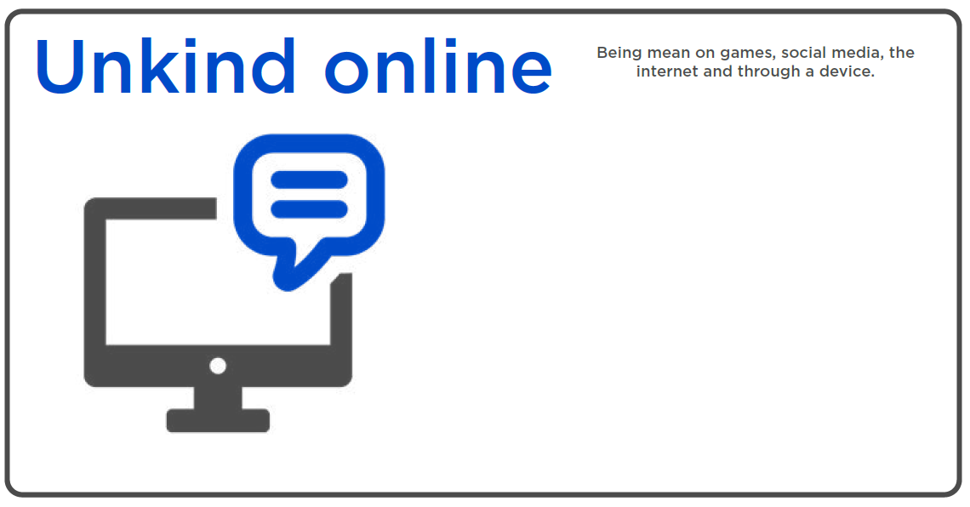
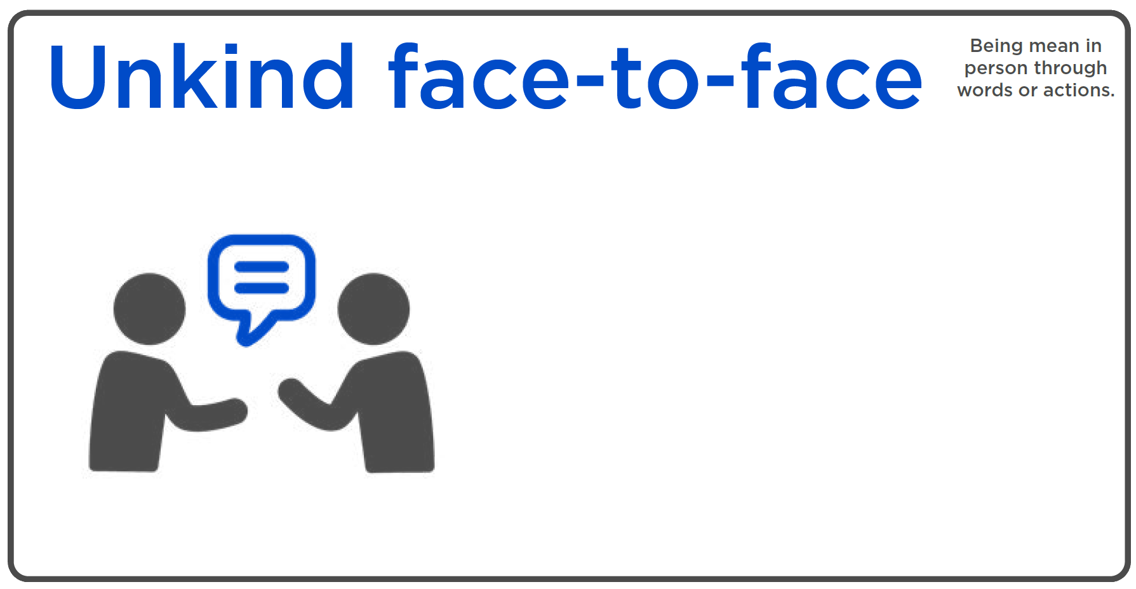
Spot the difference
Mean texts
Saying mean words after class
Leaving out someone in an online game
Kicking someone
Sending mean images

Slide 4
Did you get it right?
Unkind online
Mean texts
Being nasty on an online game
Leaving out someone in an online game
Sending mean images
Sending mean videos

Slide 5
Did you get it right?
Unkind face-to-face
Leaving someone out of your football game
Saying mean words after class
Kicking someone
Pushing someone over in the playground

Slide 6
Being unkind online
Can you think of any more ways that someone might be unkind online?

